Slide 1
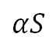
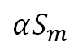
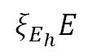
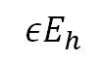
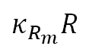
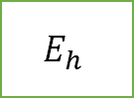
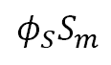
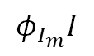
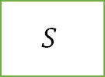
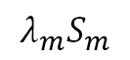
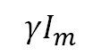
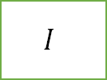
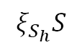
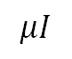
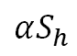
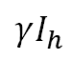
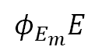
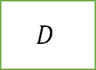
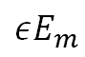
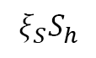
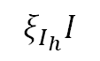
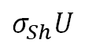
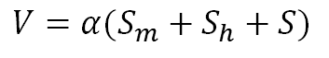
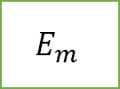
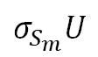
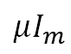
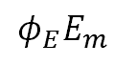

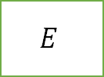
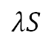
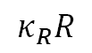
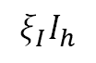
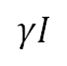
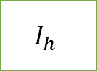
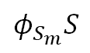
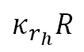
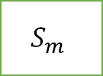
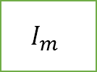
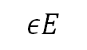
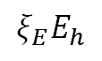
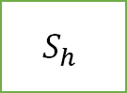
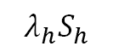
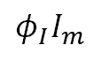
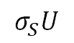
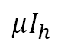
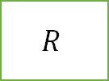
$$κ_{r_{h}}R$$
$$S_{h}$$
$$λ_{h}S_{h}$$
$$E_{h}$$
$$εE_{h}$$
$$I_{h}$$
$$σ_{Sh}U$$
$$ξ_{S}S_{h}$$
$$ξ_{E}E_{h}$$
$$μI_{h}$$
$$ξ_{E_{h}}E$$
$$ξ_{I_{h}}I$$
$$ξ_{I}I_{h}$$
$$ξ_{S_{h}}S$$
$$κ_{R}R$$
$$αS_{h}$$
$$γI_{h}$$
$$σ_{S}U$$
$$λS$$
$$εE$$
$$U$$
$$S$$
$$E$$
$$I$$
$$μI$$
$$αS$$
$$D$$
$$γI$$
$$φ_{S}S_{m}$$
$$φ_{S_{m}}S$$
$$φ_{E}E_{m}$$
$$φ_{E_{m}}E$$
$$φ_{I}I_{m}$$
$$φ_{I_{m}}I$$
$$σ_{S_{m}}U$$
$$αS_{m}$$
$$R$$
$$μI_{m}$$
$$S_{m}$$
$$E_{m}$$
$$I_{m}$$
$$γI_{m}$$
$$λ_{m}S_{m}$$
$$εE_{m}$$
$$V=α(S_{m}+S_{h}+S)$$
$$κ_{R_{m}}R$$

Slide 2
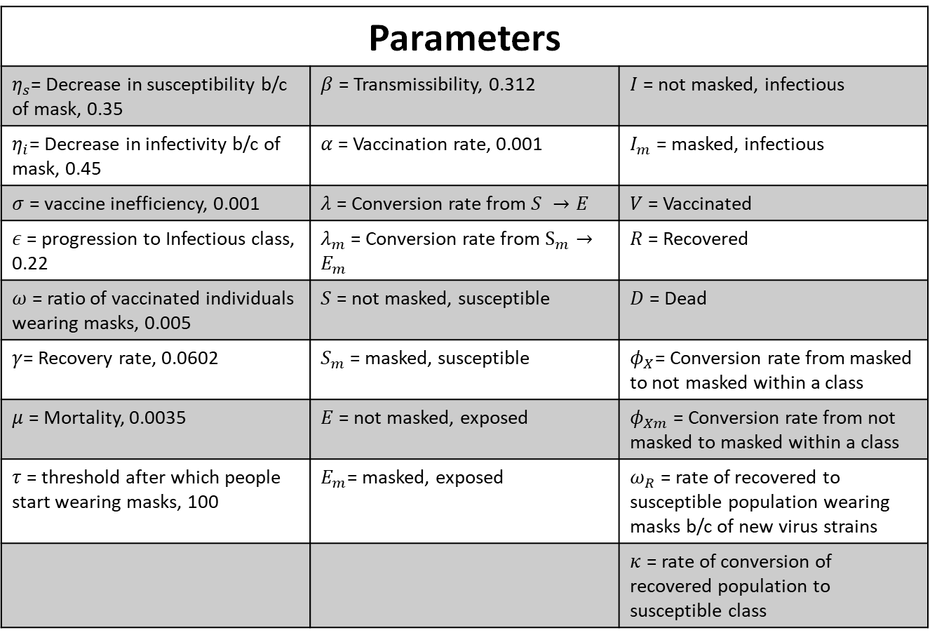
Parameter values from paper
Parameters
$η_{s}$= Decrease in susceptibility b/c of mask, 0.35 | $β$ = Transmissibility, 0.312 | $I$ = not masked, infectious
$η_{i}$= Decrease in infectivity b/c of mask, 0.45 | $α$ = Vaccination rate, 0.001 | $I_{m}$ = masked, infectious
$σ$ = vaccine inefficiency, 0.001 | $λ$ = Conversion rate from $S →E$ | $V$ = Vaccinated
$ε$ = progression to Infectious class, 0.22 | $λ_{m}$ = Conversion rate from $S_{m}→E_{m}$ | $R$ = Recovered
$ω$ = ratio of vaccinated individuals wearing masks, 0.005 | $S$ = not masked, susceptible | $D$ = Dead
$γ$= Recovery rate, 0.0602 | $S_{m}$ = masked, susceptible | $φ_{X}$= Conversion rate from masked to not masked within a class
$μ$ = Mortality, 0.0035 | $E$ = not masked, exposed | $φ_{Xm}$ = Conversion rate from not masked to masked within a class
$τ$ = threshold after which people start wearing masks, 100 | $E_{m}$= masked, exposed | $ω_{R}$ = rate of recovered to susceptible population wearing masks b/c of new virus strains
 |  | $κ$ = rate of conversion of recovered population to susceptible class

Slide 3
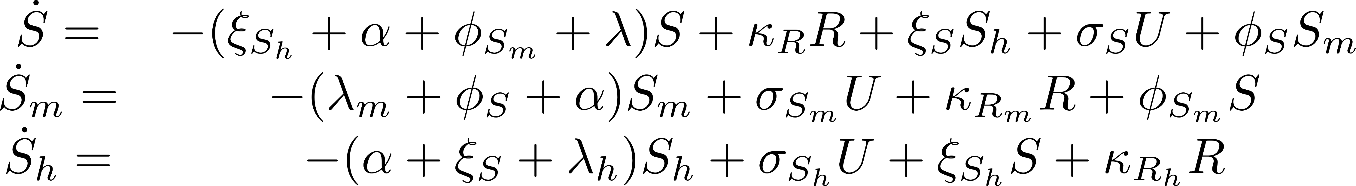
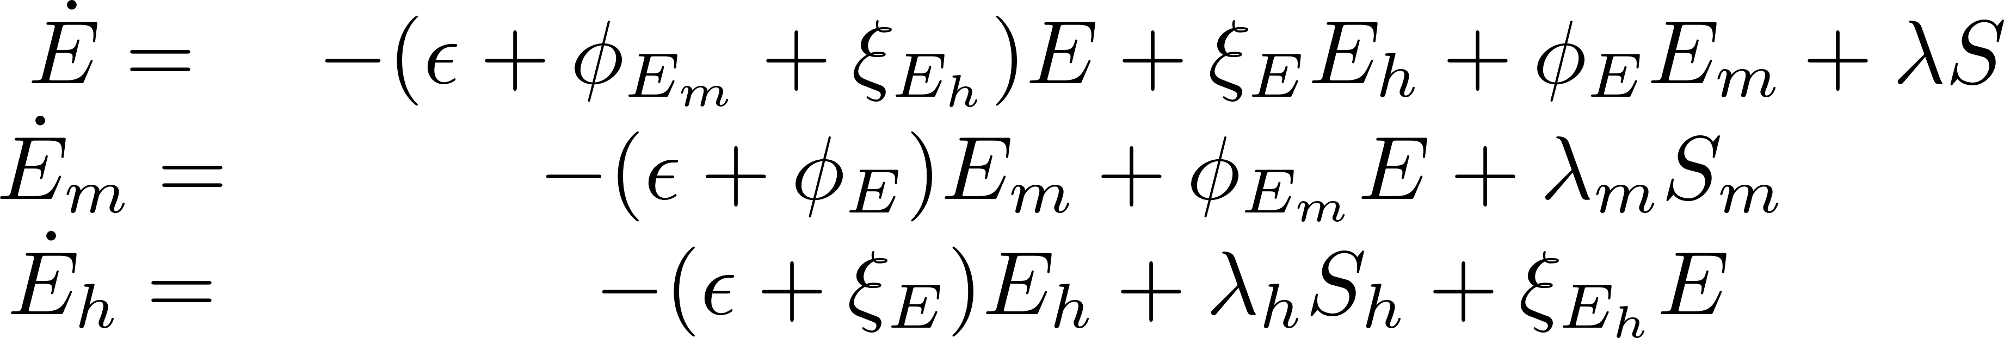
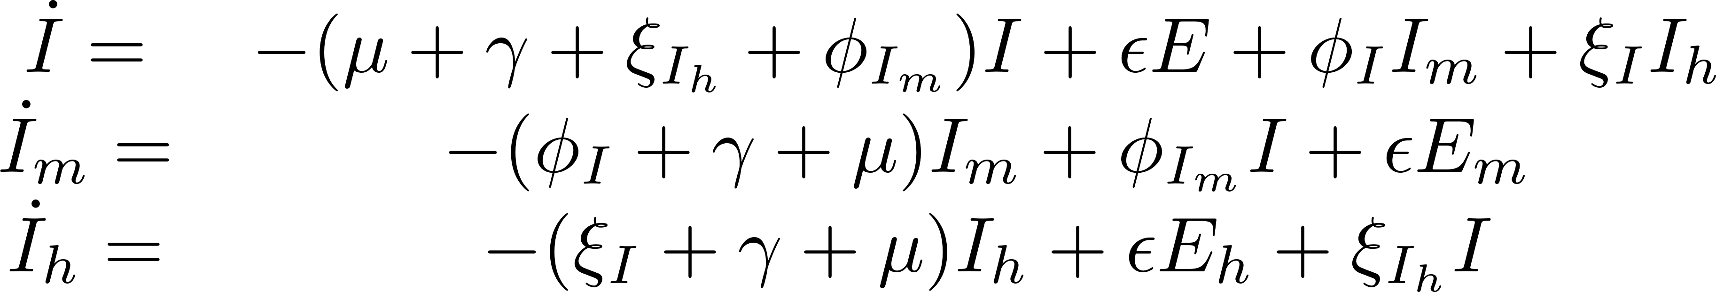
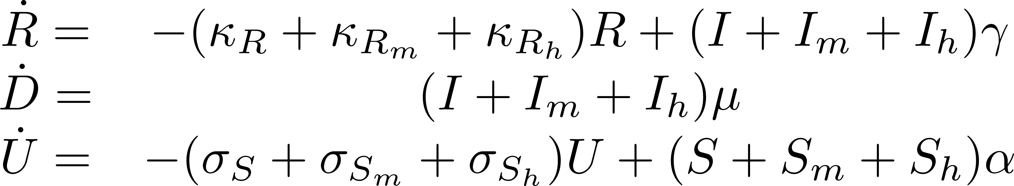

Slide 4






- Tune able Parameters

Slide 5













Objective function
$$O=w_{D}\sqrt{\sum_{t}{{\left(\hat{D\left(t\right)}−D\left(t\right)\right)}^{2}}}+w_{I}\sqrt{\sum_{t}{{\left(\hat{I\left(t\right)}−I\left(t\right)\right)}^{2}}}{+ w}_{U}\sqrt{\sum_{t}{{\left(\hat{V\left(t\right)}−V(t)\right)}^{2}}}{+ w}_{H}\sqrt{\sum_{t}{{\left(\hat{H\left(t\right)}−H\left(t\right)\right)}^{2}}}{+ w}_{M}\sqrt{\sum_{t}{{\left(\hat{M\left(t\right)}−M\left(t\right)\right)}^{2}}}$$
$$V\left(t\right)= \sum_{τ=0}^{t}{U(t)}$$
$$w_{D}=0.35, w_{I}=0.1, w_{U}=0.35, w_{H}=0.1,w_{M}=0.1$$
$$H={−(S}_{h}+E_{h}+I_{h})/(S_{h}+E_{h}+I_{h}+S_{m}+E_{m}+I_{m}+S+E+I+U+D +R)$$
$$M={(S}_{m}+E_{m}+I_{m})/(S_{h}+E_{h}+I_{h}+S_{m}+E_{m}+I_{m}+S+E+I+U+D +R)$$
Initial Conditions
$$S_{0}=9.7E6 −24$$
$$I_{0}=24$$
Other parameters start from 0
$$0.1≤φ_{1},φ_{2},ξ_{1},ξ_{2}≤1$$
$$0.01≤σ_{S}, σ_{S_{m}}, σ_{S_{h}},κ_{R_{h}},κ_{R},κ_{R_{m}}≤1$$
$$0.2≤β≤0.4$$
$$0.01≤γ≤0.3$$
$$0.001≤μ≤0.01$$
$$0.1≤η_{s_{m}}≤1.0$$
$$0.1≤η_{I_{m}}≤1.0$$
$$0.1≤ε≤1.0$$
$$0.1≤η_{S_{h}}≤1.0$$
$$0.1≤η_{I_{h}}≤1.0$$

Slide 6


Slide 7


Slide 8


Slide 9



Parameters within limits as described in previous slides
$$Initial$$
$$Δ$$
omicron

Slide 10


Slide 11


Slide 12
Appendix

Slide 13


Slide 14




- Tune able Parameters

Slide 15






Objective function
$$O=w_{D}\sqrt{\sum_{t}{{\left(\hat{D\left(t\right)}−D\left(t\right)\right)}^{2}}}+w_{I}\sqrt{\sum_{t}{{\left(\hat{I\left(t\right)}−I\left(t\right)\right)}^{2}}}{+ w}_{U}\sqrt{\sum_{t}{{\left(\hat{V\left(t\right)}−V(t)\right)}^{2}}}{+ w}_{H}\sqrt{\sum_{t}{{\left(\hat{H\left(t\right)}−H\left(t\right)\right)}^{2}}}{+ w}_{M}\sqrt{\sum_{t}{{\left(\hat{M\left(t\right)}−M\left(t\right)\right)}^{2}}}$$
$$V\left(t\right)= \sum_{τ=0}^{t}{U(t)}$$
$$w_{D}=0.35, w_{I}=0.1, w_{U}=0.35, w_{H}=0.1,w_{M}=0.1$$
$$H={−(S}_{h}+E_{h}+I_{h})/(S_{h}+E_{h}+I_{h}+S_{m}+E_{m}+I_{m}+S+E+I+U+D +R)$$
$$M={(S}_{m}+E_{m}+I_{m})/(S_{h}+E_{h}+I_{h}+S_{m}+E_{m}+I_{m}+S+E+I+U+D +R)$$
Initial Conditions
$$S_{0}=9.7E6 −24$$
$$I_{0}=24$$
Other parameters start from 0
$$0.01≤ ω_{1}, ω_{2}, θ_{1}, θ_{2},ζ_{1}, ζ_{2}, a_{1},a_{2},b_{1},b_{2}≤10$$
$$0.01≤σ_{S_{max}}, σ_{{S_{m}}_{max}}, σ_{S_{h_{max}}}, c, η_{i}≤1$$
$$300≤t_{0}≤1000$$
$$0.2≤β≤0.4$$
$$0.01≤γ≤0.3$$
$$0.001≤μ≤0.01$$
$$0.01≤η_{s_{m}}≤1.0$$
$$0.01≤η_{I_{m}}≤1.0$$
$$0.1≤ε≤0.3$$
$$0.01≤η_{S_{h}}≤1.0$$
$$0.01≤η_{I_{h}}≤1.0$$

Slide 16


Slide 17

Dry-Run with new weights

Slide 18

Death Fit

Slide 19

Vaccination fit

Slide 20

Death and Vaccination Fit

Slide 21

Multiple Fit

Slide 22

Multiple Fit

Slide 23

Multiple Fit

Slide 24

Fit
Fit with 1000 days

Slide 25

Piecewise
\kappa -2
\beta -3
\mu – 3
t1 of beta 1 is same as t1 of mu1
Lower limits of t-s to new variants
Try different objective functions including max and weighted and pareto etc.

Slide 26

Multiple Fit

Slide 27

Infectious Fit

Slide 28


